Slide 1


Adventure Works
Done By: Abdelrahman Mansour
Supervised By: Ahmed M. Hakem and Abu Bakr Makhyoun

Slide 2
Table of Contents
Project Overview
Data Integration
Data Analysis
Visualization

Slide 3
Project Overview
Project Description:
Adventure Works Cycles is a multinational company for bikes manufacturing, the company continues to grow. They demand an End To-End Business Intelligence Solution to track and analyze their sales for a better decision-making.

Slide 4
Project Overview
Project Phases:
ETL Development and Data Integration:
Tools Used: MSSQL, Microsoft SQL Server Management Studio, and Visual Studios 2022 (Using SSIS).
Data Analysis and Visualization:
Tools Used: Power BI

Slide 5
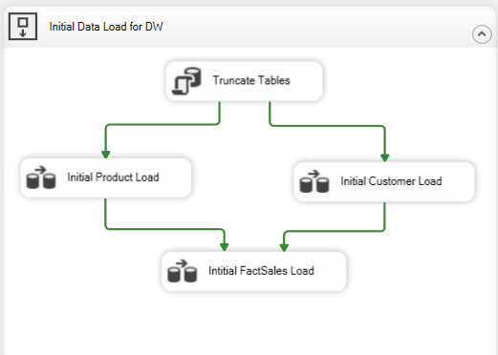
Data Integration
Control Flow:
Truncating all of DW Tables to prepare it for Initial Load.
Loading both the DimProduct and DimCustomer tables.
Loading the FactSales table.

Slide 6
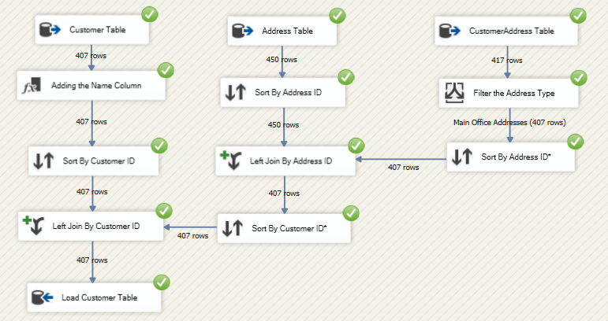
Data Integration
Customer Data Flow:

Slide 7
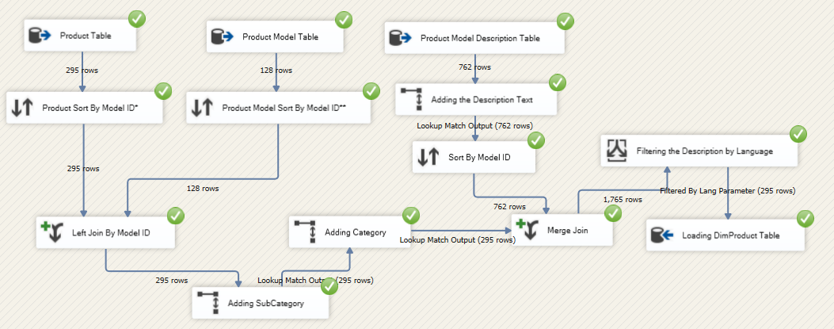
Data Integration
Product Data Flow:

Slide 8
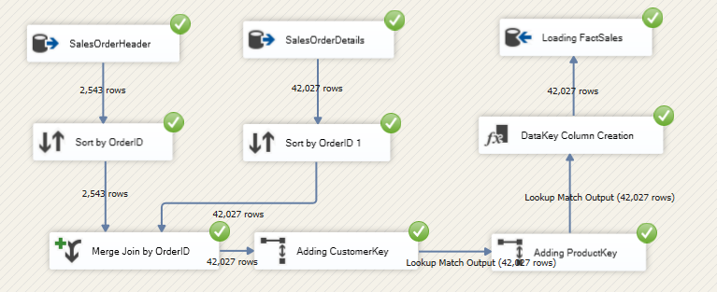
Data Integration
FactSales Data Flow:

Slide 9
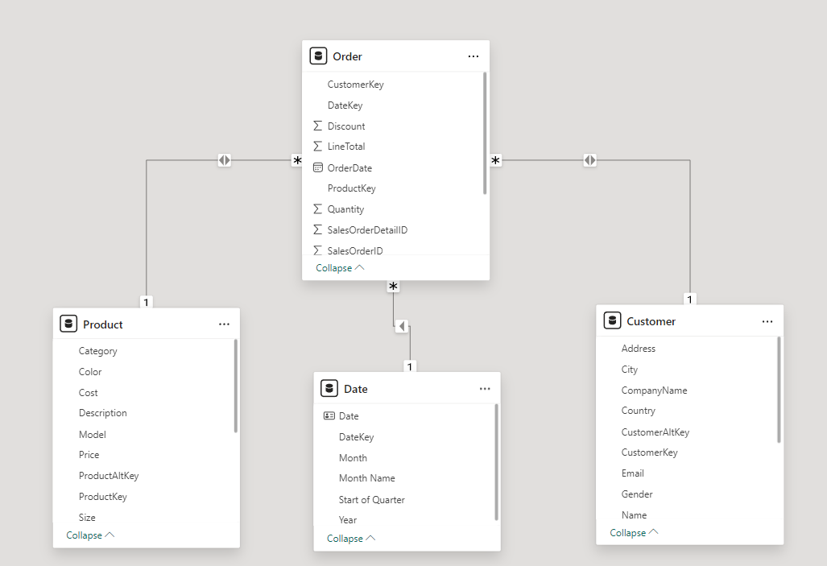
Data Analysis and Visualization
Data Model in Power BI:

Slide 10
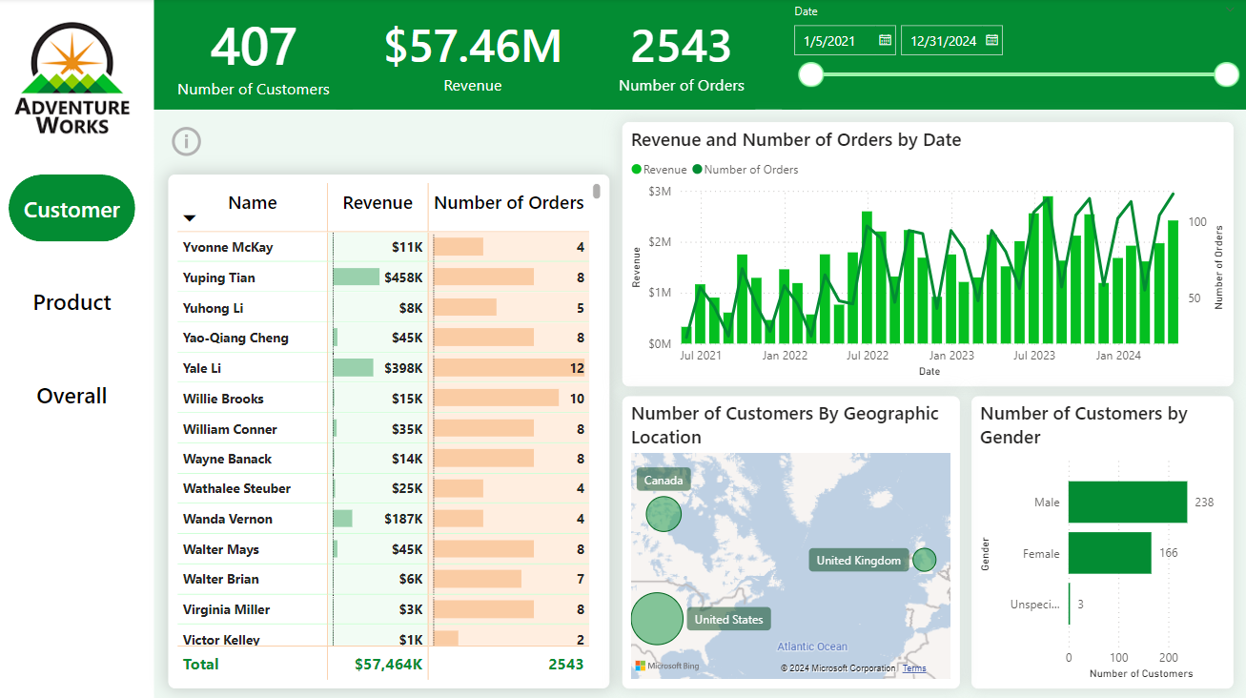
Data Analysis and Visualization
Customer Page:

Slide 11
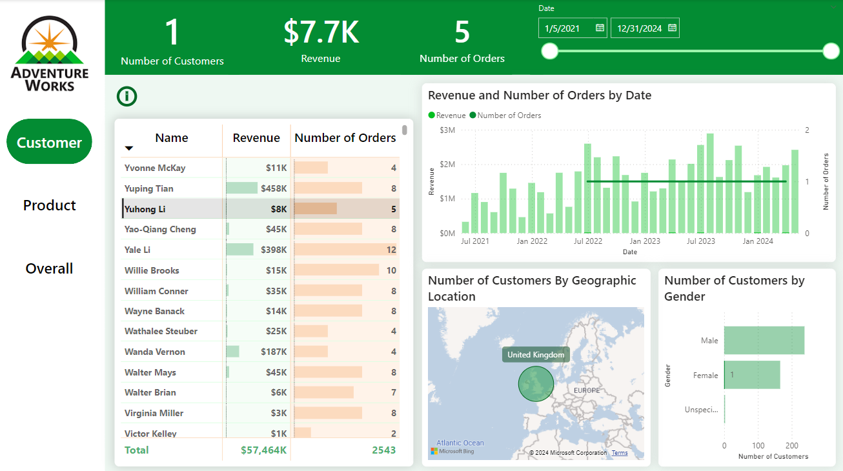
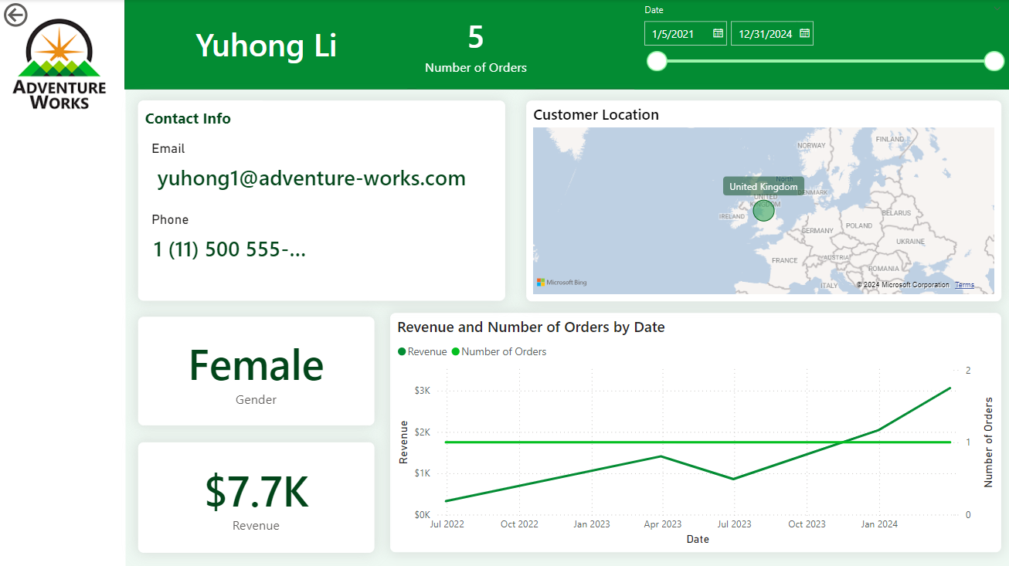
Data Analysis and Visualization
Single Customer Page:

Slide 12
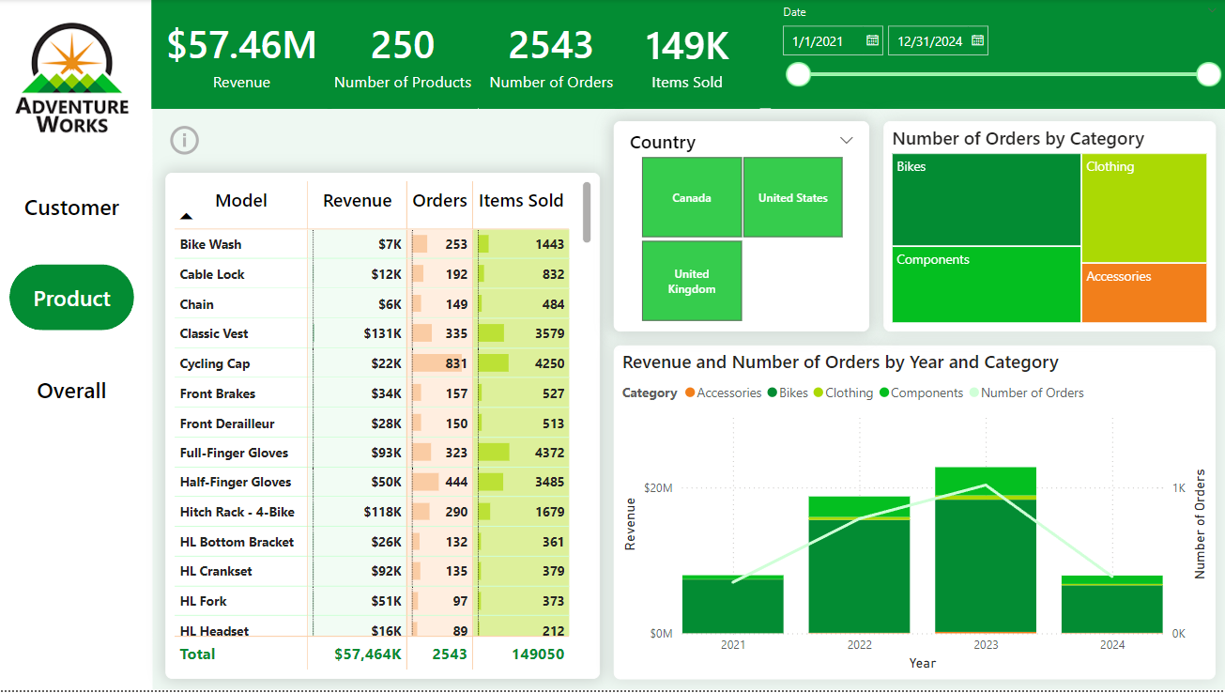
Data Analysis and Visualization
Product Page:

Slide 13
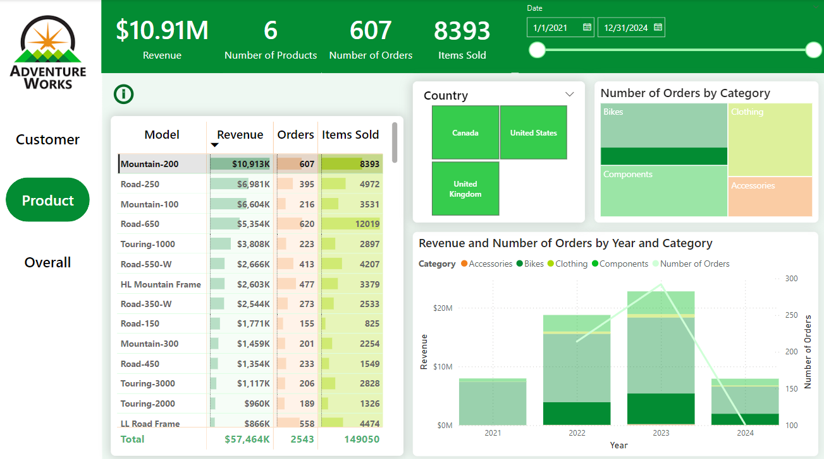
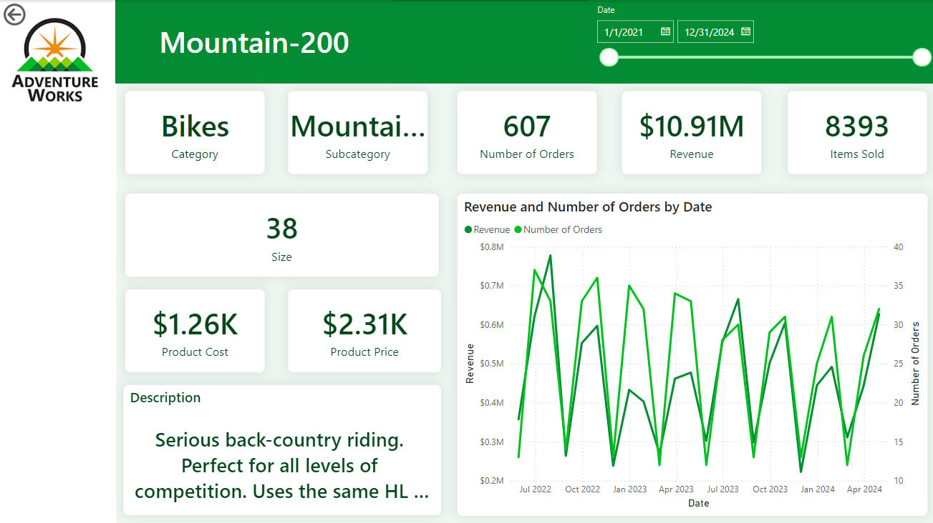
Data Analysis and Visualization
Single Product Page:

Slide 14
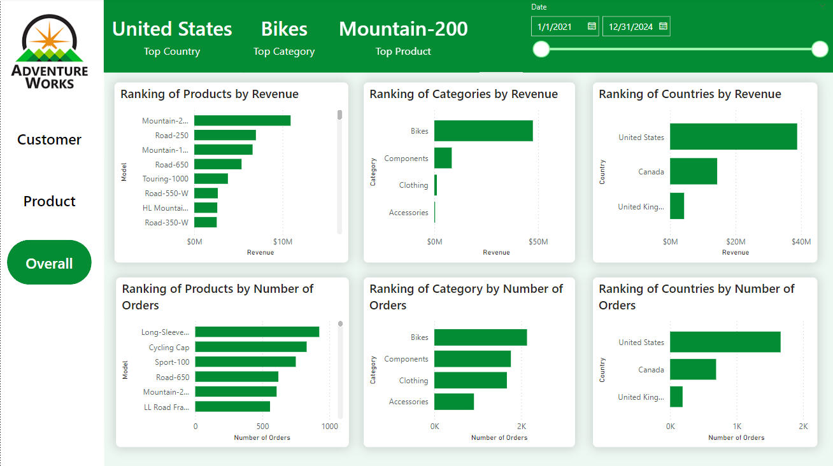
Data Analysis and Visualization
Overall Page:

